Slide 1
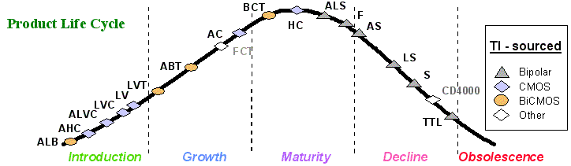
Digital Logic Families

Slide 2
Overview
Integration, Moore’s law
Early families (DL, RTL)
TTL
Evolution of TTL family
ECL
CMOS family and its evolution
Overview

Slide 3
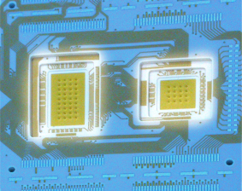
Integration Levels
Gate/transistor ratio is roughly 1/10
  SSI < 12 gates/chip
  MSI < 100 gates/chip
  LSI …1K gates/chip
  VLSI …10K gates/chip
  ULSI …100K gates/chip
  GSI …1Meg gates/chip

Slide 4
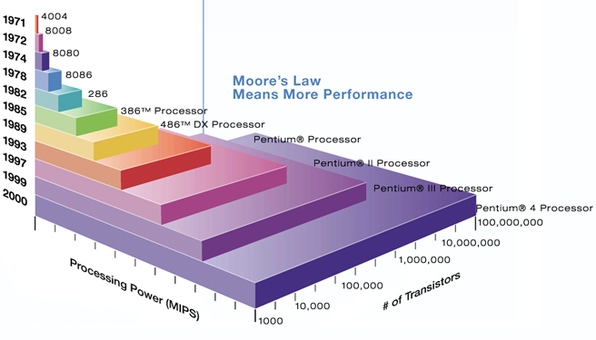
Moore’s law
A prediction made by Moore (a co-founder of Intel) in 1965: “… a number of transistors to double every 2 years.”

Slide 5
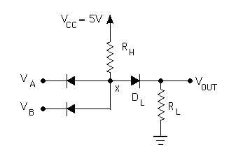

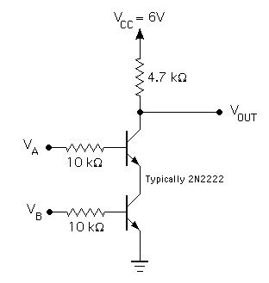

In the beginning…
Diode Logic (DL)
simplest; does not scale
NOT not possible (need an active element)
=
Resistor-Transistor Logic (RTL)
replace diode switch with a transistor switch
can be cascaded
large power draw
=
Notes:
RTL had economic advantage in that very few transistors were used. It was important when transistors were expensive to make (more expensive than resistors). Such times have long past.

Slide 6
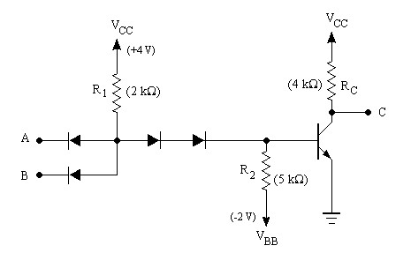
was…
Diode-Transistor Logic (DTL)
essentially diode logic with transistor amplification
reduced power consumption
faster than RTL
=
DL AND gate
Saturating inverter
Notes:
RTL had economic advantage in that very few transistors were used. It was important when transistors were expensive to make (more expensive than resistors). Such times have long past.

Slide 7
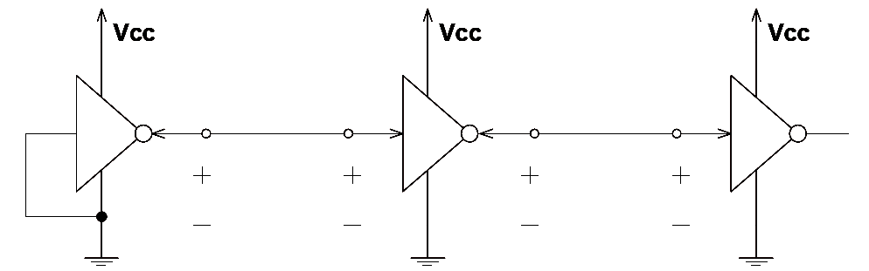
Logic families: V levels
V_{OH}(min) – The minimum voltage level at an output in the logical “1” state under defined load conditions
V_{OL}(max) – The maximum voltage level at an output in the logical “0” state under defined load conditions
V_{IH}(min) – The minimum voltage required at an input to be recognized as “1” logical state
V_{IL}(max) – The maximum voltage required at an input that still will be recognized as “0” logical state
V_{OH}
V_{IH}
V_{OL}
V_{IL}
Notes:
These are: high-level output voltage (OH), low-level output voltage (OL), high-level input voltage (IH), low-level input voltage (IL)

Slide 8
Logic families: I requirements
I_{OH} – Current flowing into an output in the logical “1” state under specified load conditions
I_{OL} – Current flowing into an output in the logical “0” state under specified load conditions
I_{IH} – Current flowing into an input when a specified HI level is applied to that input
I_{IL} – Current flowing into an input when a specified LO level is applied to that input
I_{OH}
I_{IH}
I_{OL}
I_{IL}
V_{OH}
V_{IH}
V_{OL}
V_{IL}

Slide 9
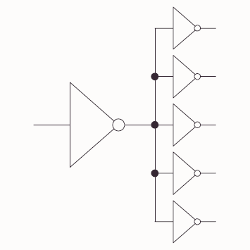
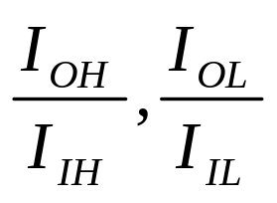
Logic families: fanout
Fanout: the maximum number of logic inputs (of the same logic family) that an output can drive reliably
DC fanout = min( )

Slide 10
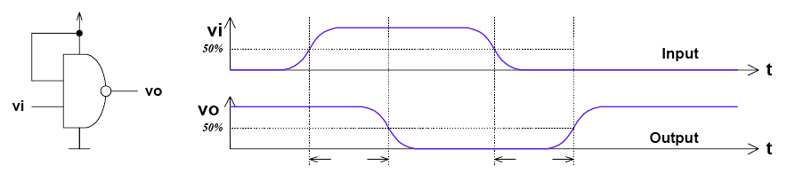
Logic families: propagation delay
T_{PD,HL}
T_{PD,LH}
T_{PD,HL} – input-to-output propagation delay from HI to LO output
T_{PD,LH} – input-to-output propagation delay from LO to HI output
Speed-power product: T_{PD} × P_{avg}

Slide 11
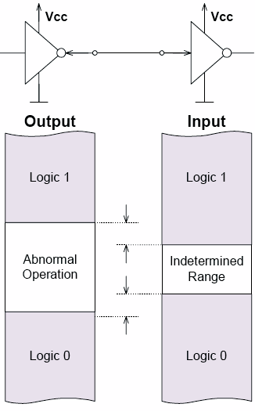
Logic families: noise margin
HI state noise margin:
V_{NH} = V_{OH}(min) – V_{IH}(min)
LO state noise margin:
V_{NL} = V_{IL}(max) – V_{OL}(max)
Noise margin:
V_{N} = min(V_{NH},V_{NL})
V_{NH}
V_{NL}

Slide 12
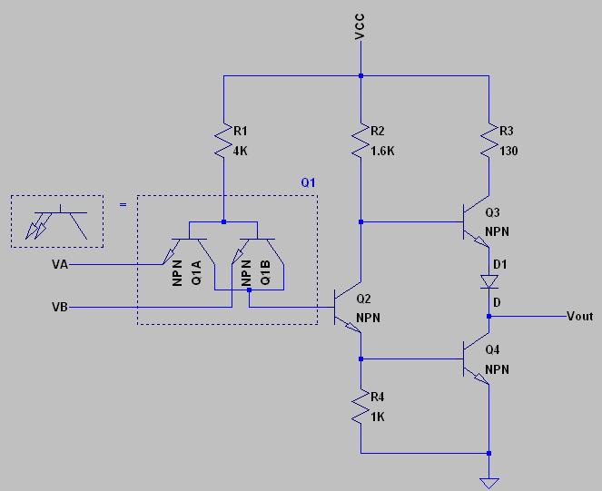
TTL
Bipolar Transistor-Transistor Logic (TTL)
first introduced by in 1964 (Texas Instruments)
TTL has shaped digital technology in many ways
Standard TTL family (e.g. 7400) is obsolete
Newer TTL families still used (e.g. 74ALS00)
Distinct features
Multi-emitter transistors
Totem-pole transistor arrangement
Open LTspice example: TTL NAND…
2-input NAND

Slide 13
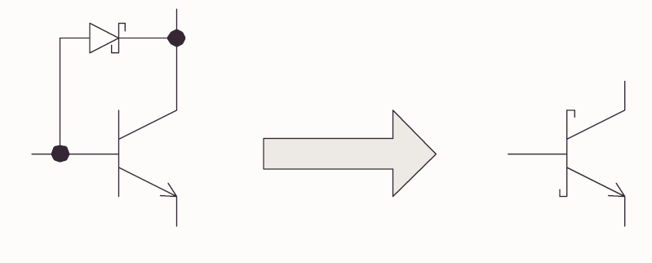
TTL evolution
Schottky series (74LS00) TTL
A major slowdown factor in BJTs is due to transistors going in/out of saturation
Shottky diode has a lower forward bias (0.25V)
When BC junction would become forward biased, the Schottky diode bypasses the current preventing the transistor from going into saturation
Notes:
These also have lower power requirements than the standard TTL

Slide 14
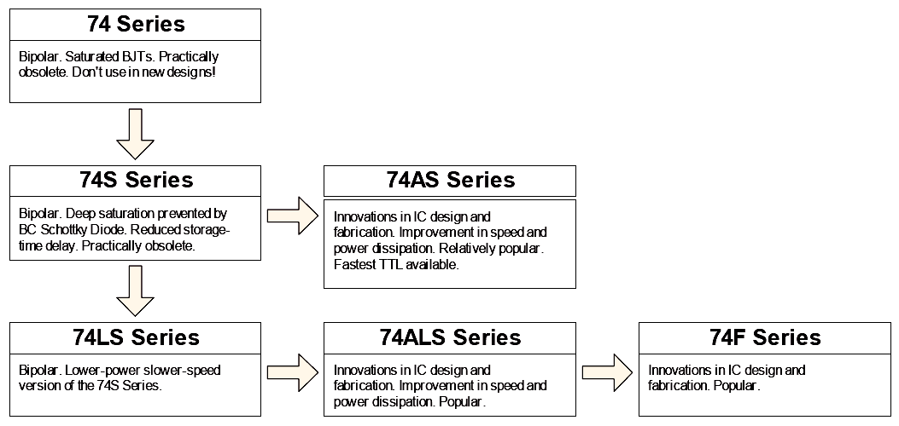
TTL family evolution
Legacy: don’t use in new designs
Widely used today
Notes:
These also have lower power requirements than the standard TTL

Slide 15
ECL
Emitter-Coupled Logic (ECL)
PROS: Fastest logic family available (~1ns)
CONS: low noise margin and high power dissipation
Operated in emitter coupled geometry (recall differential amplifier or emitter-follower), transistors are biased and operate near their Q-point (never near saturation!)
Logic levels. “0”: –1.7V. “1”: –0.8V
Such strange logic levels require extra effort when interfacing to TTL/CMOS logic families.
Open LTspice example: ECL inverter…
Notes:
These also have lower power requirements than the standard TTL

Slide 16
CMOS
Complimentary MOS (CMOS)
Other variants: NMOS, PMOS (obsolete)
Very low static power consumption
Scaling capabilities (large integration all MOS)
Full swing: rail-to-rail output
Things to watch out for:
  don’t leave inputs floating (in TTL these will float to HI, in CMOS you get undefined behaviour)
  susceptible to electrostatic damage (finger of death)
Open LTspice example: CMOS NOT and NAND…
Notes:
These also have lower power requirements than the standard TTL

Slide 17
CMOS/TTL power requirements
TTL power essentially constant (no frequency dependence)
CMOS power scales as ∝ f × C × V²
At high frequencies (>> MHz) CMOS dissipates more power than TTL
Overall advantage is still for CMOS even for very fast chips – only a relatively small portion of complicated circuitry operates at highest frequencies
frequency
supply volt.
eff. capacitance
Notes:
These also have lower power requirements than the standard TTL

Slide 18
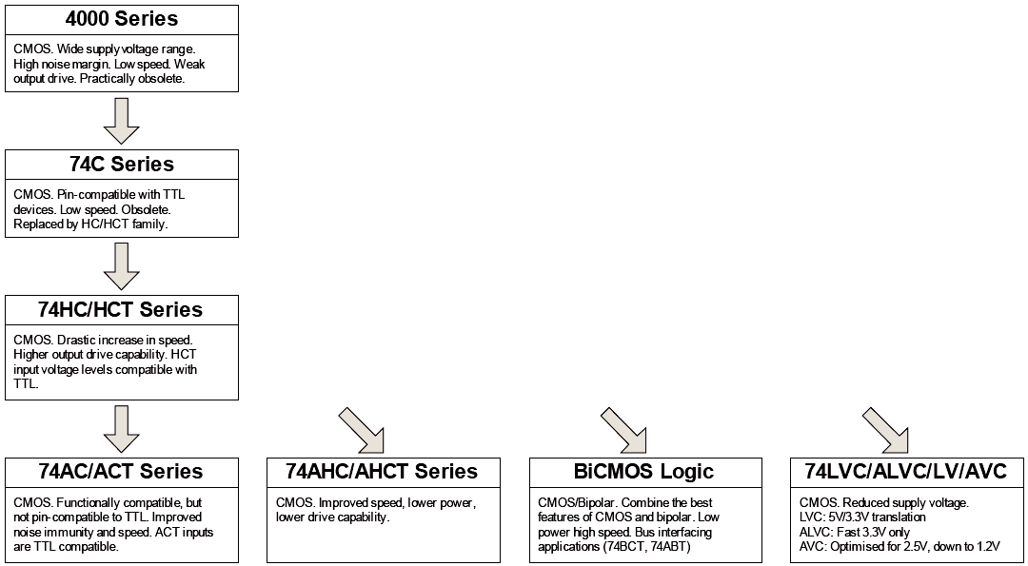
CMOS family evolution
obsolete
General trend:
Reduction of dynamic losses through successively decreasing supply voltages: 12V → 5V → 3.3V → 2.5V → 1.8V
CD4000 LVC/ALVC/AVC
Power reduction is one of the keys to progressive growth of integration
Notes:
These also have lower power requirements than the standard TTL

Slide 19
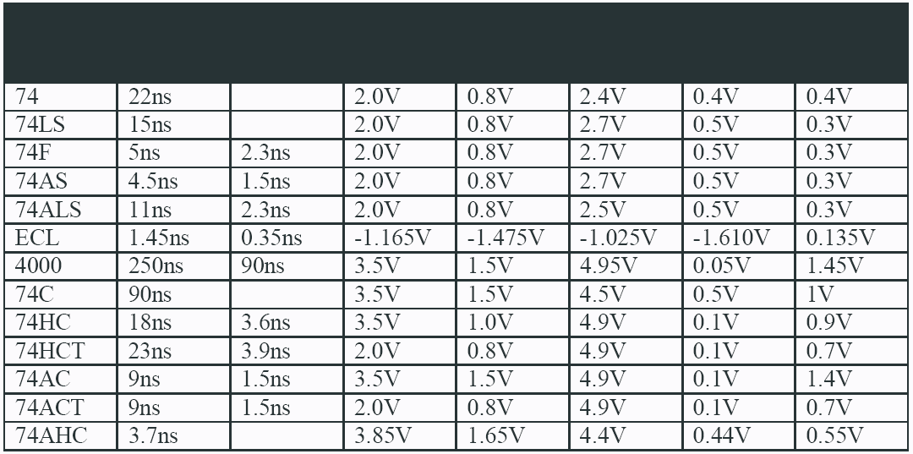
Overview
TTL
Logic
Family
T_{PD} T_{rise/fall} V_{IH,min} V_{IL,max} V_{OH,min} V_{OL,max}
Noise
Margin
Values typical for V_{cc}/V_{dd} = 5V
When interfacing different families, pay attention to their input/output voltage, current (fanout) specs.
CMOS
Notes:
These also have lower power requirements than the standard TTL

Slide 20
Life-cycle
Notes:
These also have lower power requirements than the standard TTL

